Slide 1
RNN Sequence Data
I2A2 Challenge January 2022
Philippe Béliveau

Slide 2

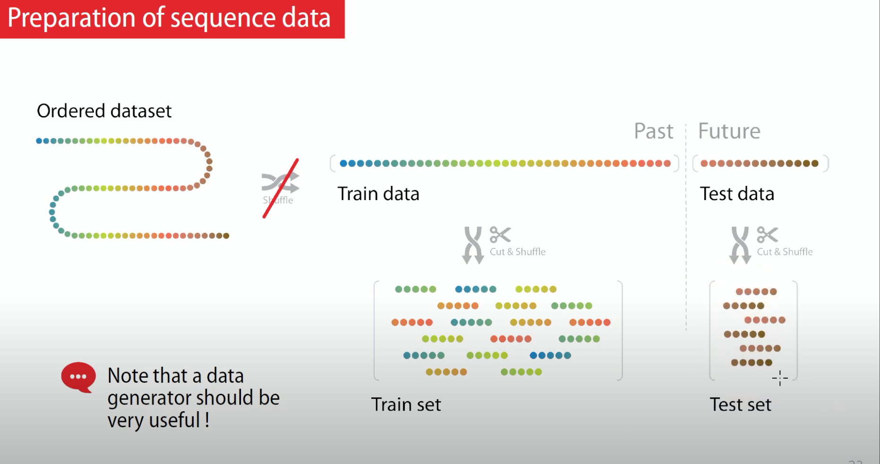
Sequence Data
Source: *Fidle
Where the past must convey information about the future
Notes:
An example of data that his sequence but that his past do not convey information about the future could be the stock market. LSTM could have a really hard time

Slide 3
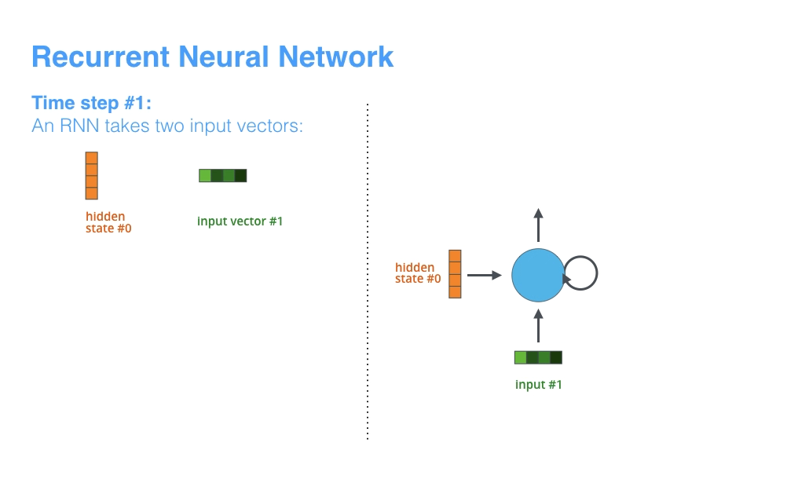
Underlying Mechanism
https://jalammar.github.io/visualizing-neural-machine-translation-mechanics-of-seq2seq-models-with-attention/
Notes:
My understanding:
The RNN takes the first input, which in the case of a sentences, he will read the first word and output a hidden state, We can think here about this hidden state as the information retain by the model about the previous word. After having process the first word and outputing the first output, he will pass as input the second word of the sentence and update its hidden state with the new inputs and the previous input it has seen.
He will do this with every word in the sentence, until he has seen every word in the input, to then predict the next word.

Slide 4
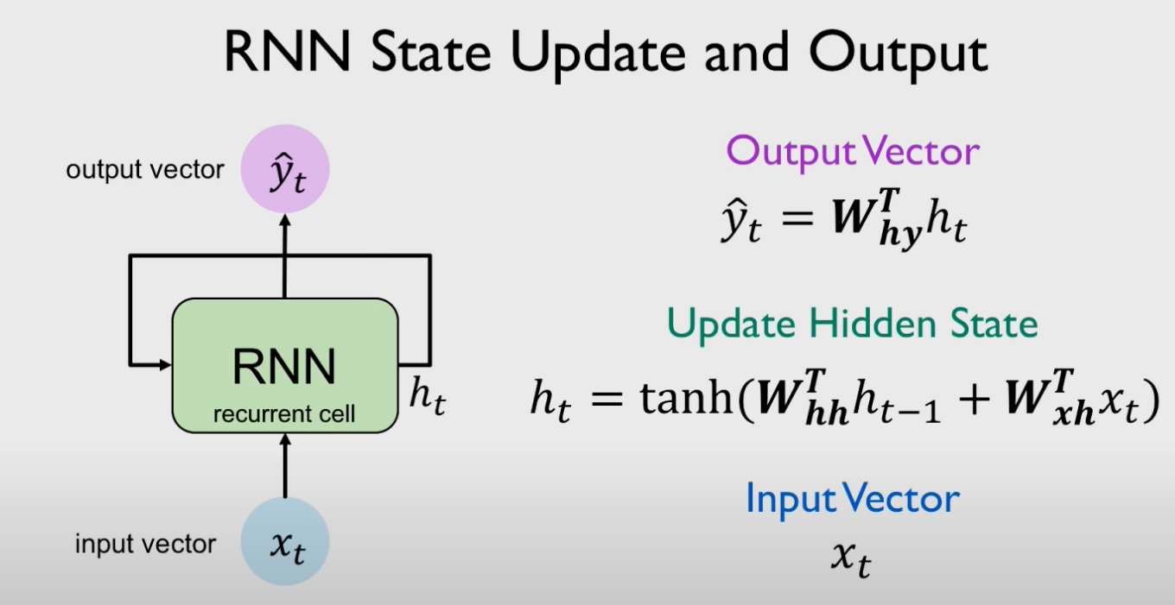
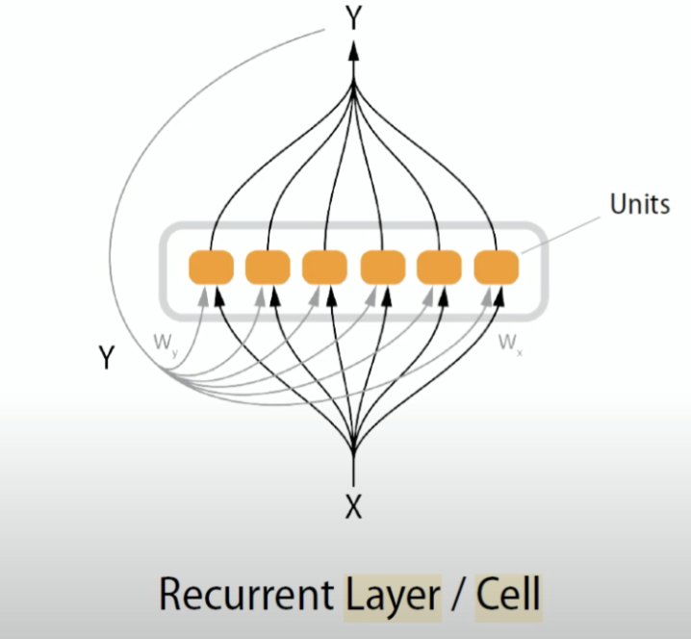
Underlying Mechanism
Source: *MIT series on Deep Learning
Source: *Fidle
Notes:
Allow information to persist over time, by looping his output and continuously updating his state.
We see here that the output vector if s junction of a dot-products between the weight of the hidden state times his vector, with the dot-products of the weight of the input times the input at time t.
Important point: important point here is that in this computation it's the same function f of W and the same set of parameters that are used at every time step and it’s those set of parameters that we actually learn during the course of training
-> Instead of a solo neuro and outputing a scalar, we are going to create a layer that will procure us a vector.

Slide 5
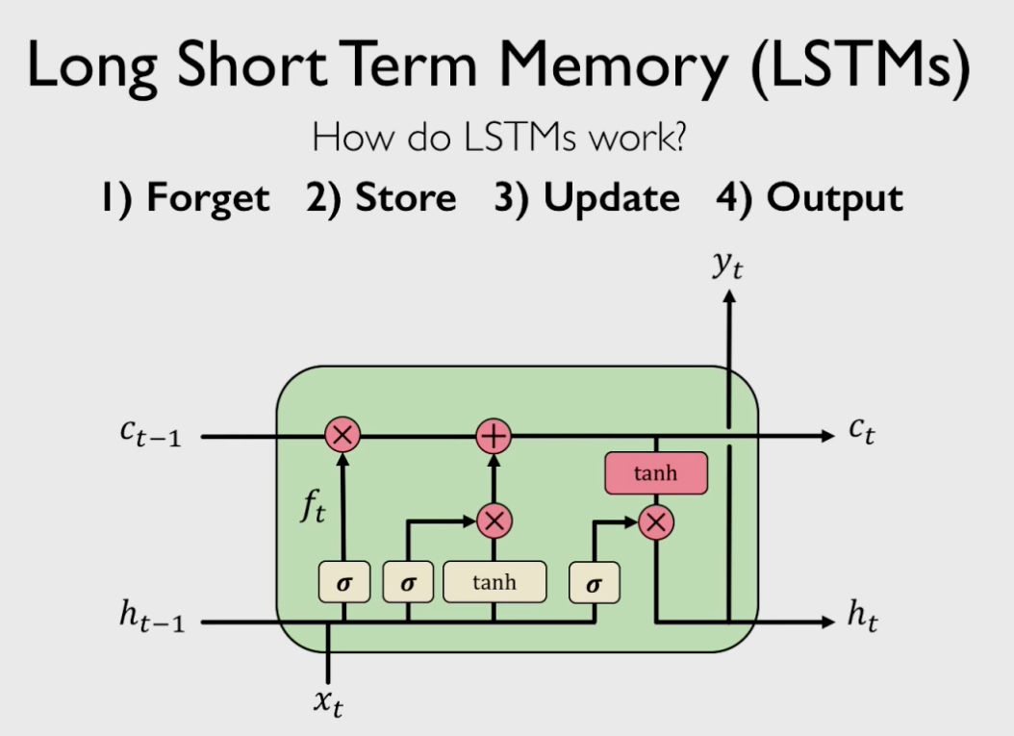
Limitation
Vanishing gradient
Solution
Multiply multiple small numbers together
Error further back the time steps have smaller and smaller gradients
Bias parameter seems to capture only short-term dependencies
Activation function
Trick initialize weights
Architecture
Notes:
Activation Function:
For sigmoid and Tan H, we can have derivatives that are less than one, which create this vanishing gradient problem, although we could change the activation function for RELU. Relu activation have a derivatives of 1 whenever x is greater than 0.
Trick initialize the weights:
it turns out that
initializing the weights to the identity
matrix helps them helps prevent them
from shrinking to zero too rapidly
during back propagation
Trick architecture:
Use of gates
LSTM is the sequence of how they regulate information flow, storage and forgetting irrelavant history information.
It is storing what is new an. Important, using this info to update his state and generates output.

Slide 6
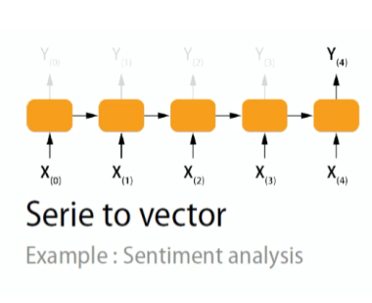
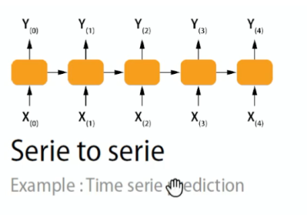
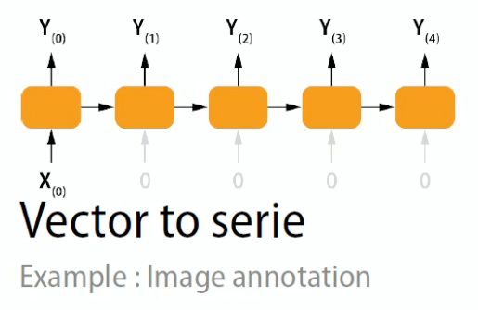
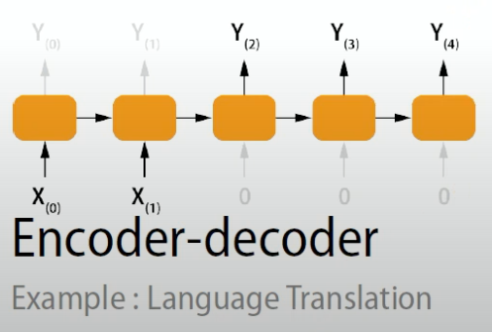
Application
Time series/Music Generation
Sentiment classification
Image Annotation
Translation
Notes:
Serie to serie:
Here we want to output a prediction at each timestep, this hives us the opportunity to output multiple timestep. He will give an exemple further in the presentation and the parameter that needs to be activate to permit this.
Serie to vector:
The objective is to train an RNN network to predict the n+1 vector off our input sequence.
Vector to serie:
We are giving a image to the model, he collect the information, build a vector within what he learned, then give it to a RNN layer and this network can generate a text describing what his happening in the image

Slide 7
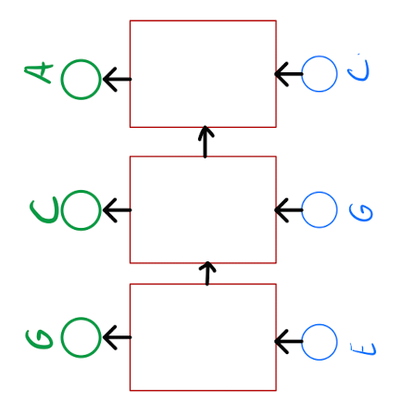
Application Series to series

Slide 8
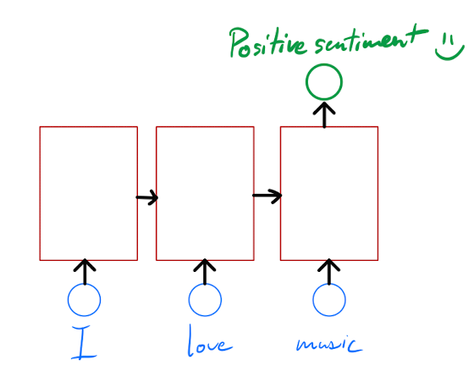
Application Serie to vector

Slide 9
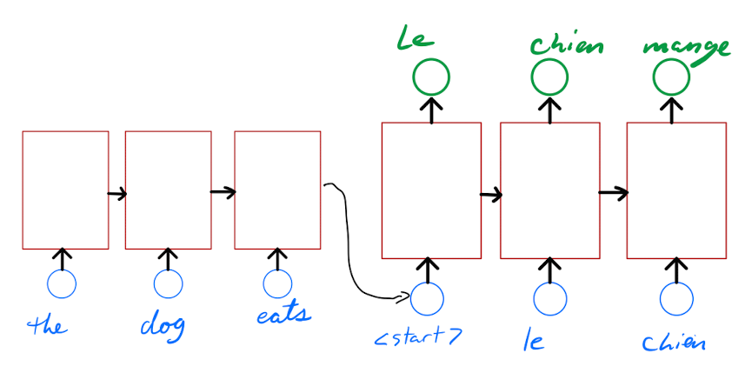
Application Encoder-decoder
Notes:
Limitation of LSTM we will be present later in the presentation

Slide 10
Data preparation
Stationary (remove trend & seasonality)
Scaling [-1, 1] for tanh
Time Series Generator
Sliding window
Single output
Multi-step ahead forecast
How to easily divide our dataset to be feed in the model?
Notes:
https://colab.research.google.com/github/srivatsan88/End-to-End-Time-Series/blob/master/Time_Series_Functions_for_Sequencing.ipynb
Multivariate time series modeling
https://github.com/srivatsan88/End-to-End-Time-Series/blob/master/Multivariate_Time_Series_Modeling_using_LSTM.ipynb
The dataset is about the energy consumption of the appliance, the features contains the energy use of the lights, the temperature outside, the humidity in the kitchen and the visibility from the weather station.
TimeSeriesgenerator:
When dividing the dataset, we are using features and target, we keep as features the target itself as it is the concept itself of lstm
We see that the target vector that his output is the 3 timestep, as in the code, we set the length to 2, meaning we are looking at the 2 timesteps before and want to predict the 3rd time steps.
We also make sure to not shuffle the data.
Window_lenght = on a day of 10 min interval, I have 144 datapoints. Thus 5 days of data

Slide 11
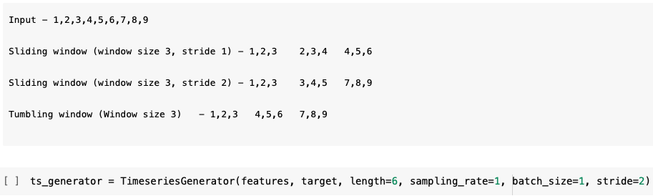
Data preparation Sliding window

Slide 12
Handling Missing Data & outliers
NaN
-1
model.add(Masking(mask_value=-1, input_shape=(2, 1)))
Trained the model as-is
Notes:
There are two main ways to deal with missing sequence data:
1. The first one is to make the model learn with the missing value by replacing the value with a value that does not appear naturally in the input. Such as -1 when you normalize your data between [0,1]
So you simply replace the NaN value and train your model as-is
2. Masking missing value
We can use a masking layer as the first layer to the network
When defining the layer, we can specify which value we want to mask. You can play with it by only masking the timestep if all the features are having a missing value, then you remove the timestep.
As you see, you have to specify the input shape as the mask layer is the first layer.
3. Techniques for outlers:
I haven’t dig enough into that, but I saw a couple of tutorial, when dealing with outliers in a sequence data problem, using the minmaxscaler instead of the standard scaler.

Slide 13
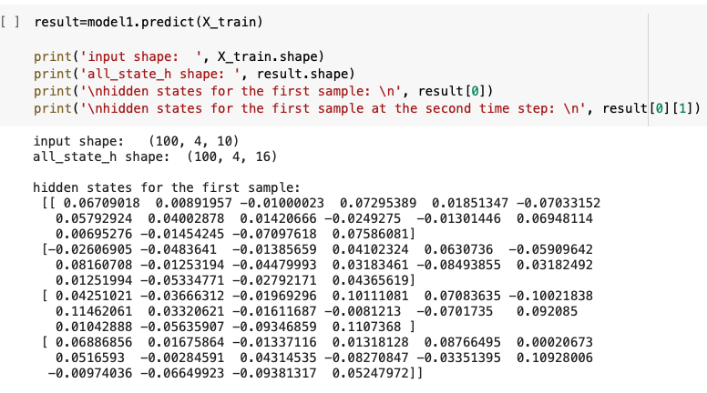
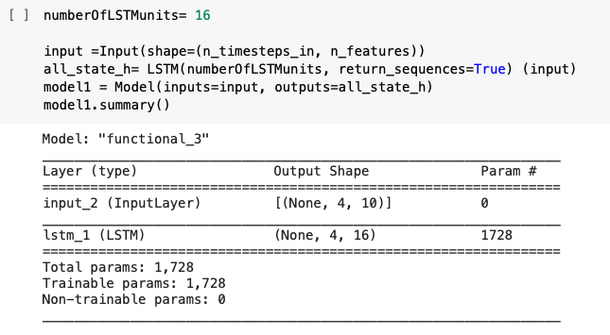
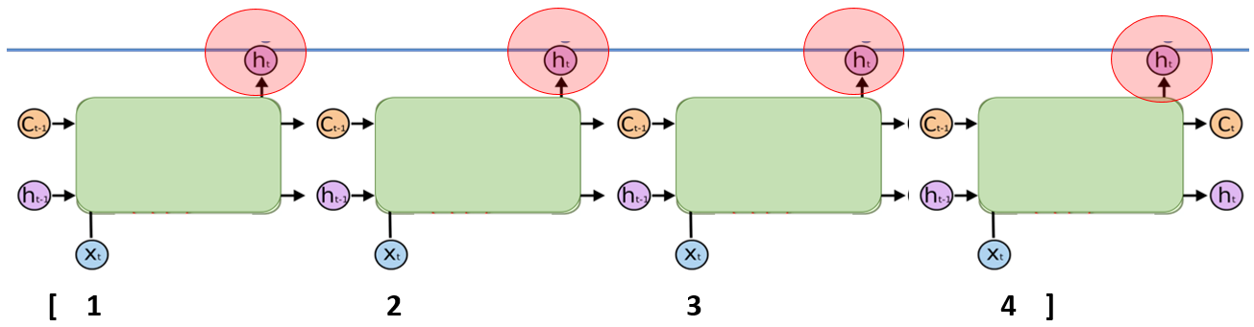
Interpreting LSTM Return_sequences=True

Slide 14
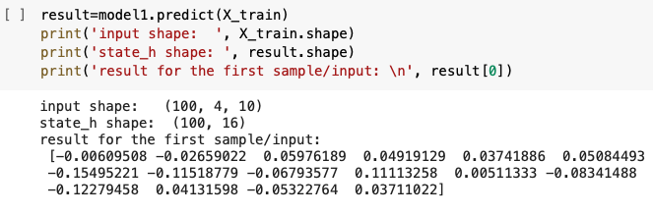
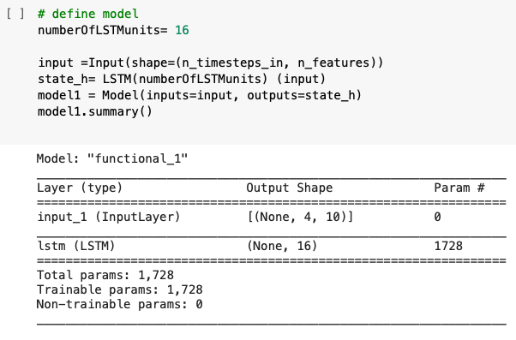
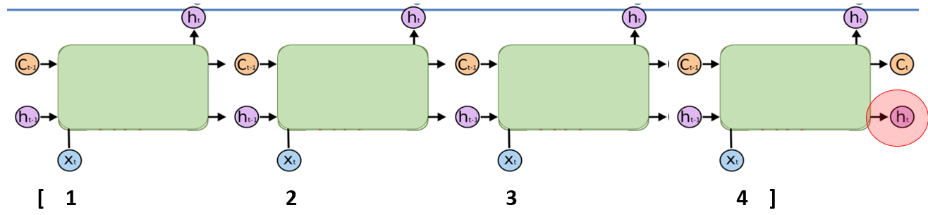
Interpreting LSTM Return_sequences=Default

Slide 15
RNN Hyperparameter
Hyperparameters
Batch size (larger)
Activation function: Relu
Dropout: 0.5
Decay rate
Momentum: [0.5. 0.9]
Features and timesteps: Explore lag values
Optimization Setup
Adaptive learning: Adam optimizer
Truncated backpropagation: training on overlapping chunks of 200 steps, gradually increasing in training
Model parameters
Bias due to forget gate: Enable the model to learn to remember the info of last steps. Bias for forget gate =1
Regularization: Dropout!
LSTM really prone to overfitting
Notes:
Batch size: Batch size controls how often to update the weights of the network. It has been shown that smaller batch size could help prevents overfitting, although a consequences might be
A batch size of 1 is technically performing online learning.
That is where the network is updated after each training pattern. This can be contrasted with batch learning, where the weights are only updated at the end of each epoch.
Momentum: Momentum is a unique hyperparameter which allows the accumulation of the gradients of the past steps to determine the direction to go with, instead of using the gradient of only the current step to guide the search.
Optimization: Adam: To better handle the complex training dynamics, as plain gradient descent can’t handle.
Dropout:
parameter p controlling the probability of units being dropped. In this case, when we use p=0.5 we are essentially asking PyTorch to drop each unit with probability 50%.

Slide 16
Application Encoder-decoder
Notes:
Going back to the slide on the application encoder-decoder, if we examine it closely, we see that the model has a dual structure with an encoder and decoder,

Slide 17
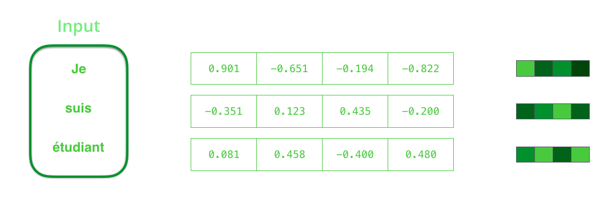
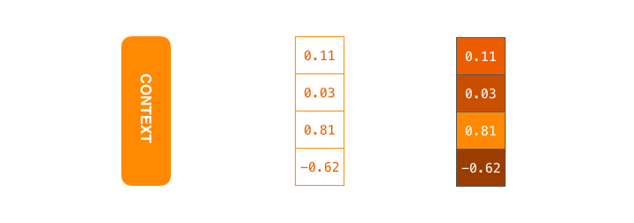
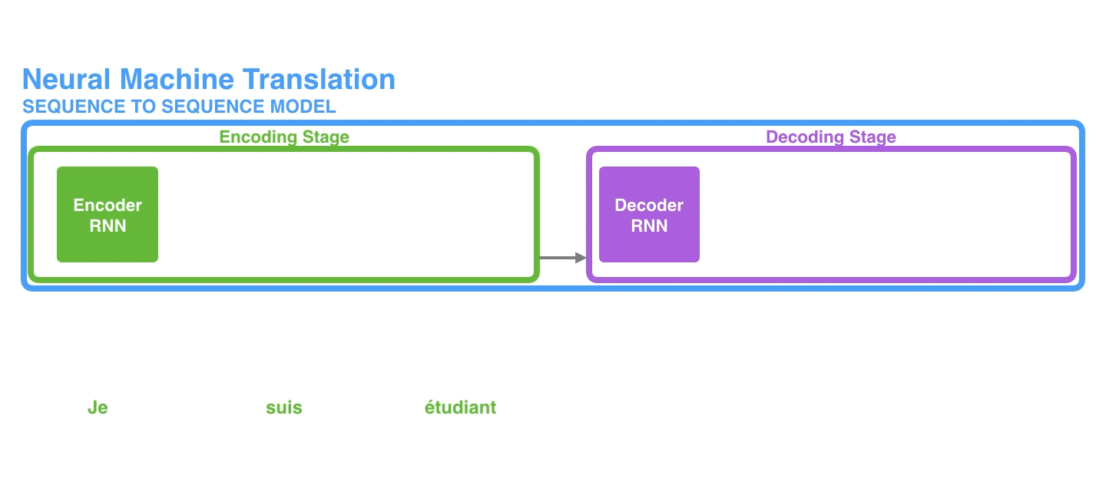
RNN in translation
Limitation of RNN
Too big of a load of information to encode in a single vector
What regular RNN are doing?
https://jalammar.github.io/visualizing-neural-machine-translation-mechanics-of-seq2seq-models-with-attention/
Notes:
The encoder ecnode the sentences by processing each item in the input sequence in its original language, then it compiles the information and capture it into a vector, which we called context vector or the hidden state, and then a decoder takes that vector representation as inputs and produce the output sequence of each item. Both encoder and encoder are RNN.
The problem here is that the entire content as to be encoded into a single vector and that is actually a huge amount of information for regular RNN.
To get around this problem, a new architecture has been built, instead of having access to the final encoded state of all the time steps in the original sentence, (see visualization)
Word embedding:
The word, however, needs to be represented by a vector. To transform a word into a vector, we turn to the class of methods called “word embedding” algorithms. These turn words into vector spaces that capture a lot of the meaning/semantic information of the words (e.g. king - man + woman = queen).

Slide 18
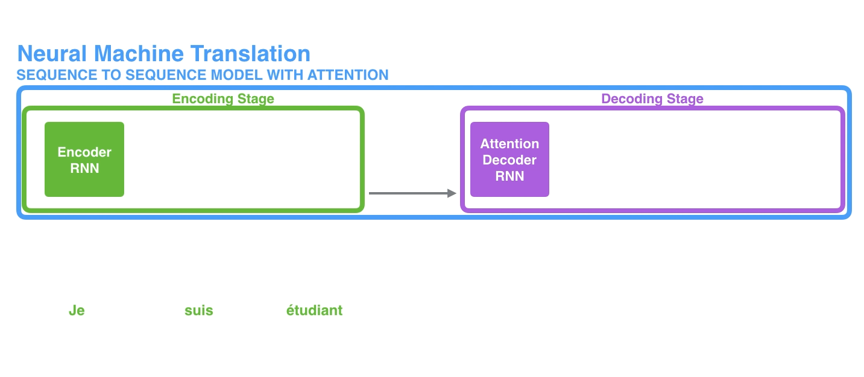
Attention
First way
1. We pass all the hidden state to the decoder, instead of only one
What attention does to get around this massive load of information?
Second way
He looks carefully at each of the hidden state, which are then associated with a certain word in the input sequence.
Give each hidden state a score
Then he multiply each hidden state by its softmaxed score, which amplify H_s with high score and diminish the one with low score
Notes:
First: Instead of simply passing to the decoder the last hidden state, we pass all the hidden states.
Second: Extra steps are done by the decoder,:
He looks carefully at each of the hidden state, each hidden state is associated with a certain word in the input sequence.
Give each hidden state a score
Then he multiply each hidden state by its sofmaced score, which

Slide 19
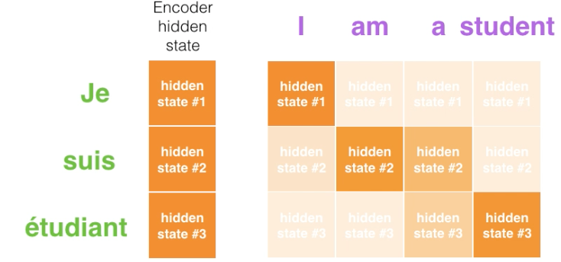
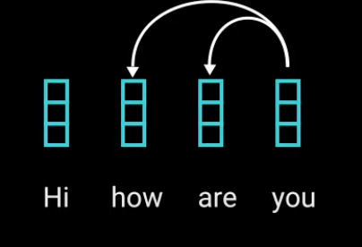
1. Association of words
Notes:
Self-attention: Allows the model to associate each individuals world of the input to other words in the input
For example, here you learn his relation with other words

Slide 20
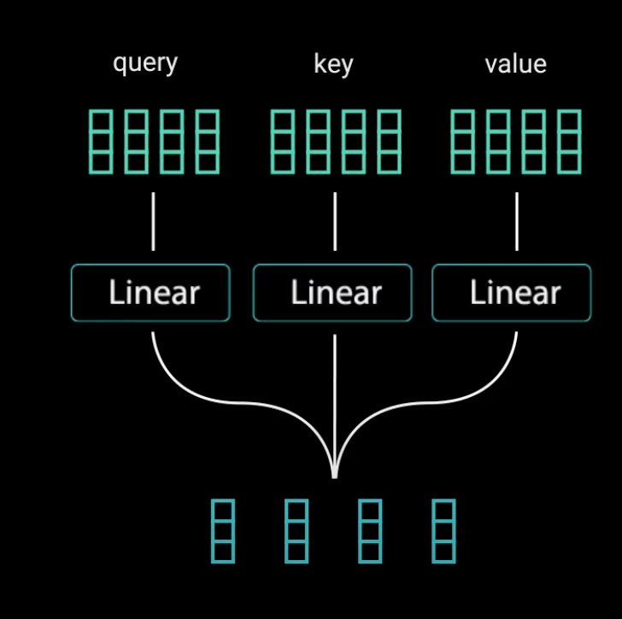
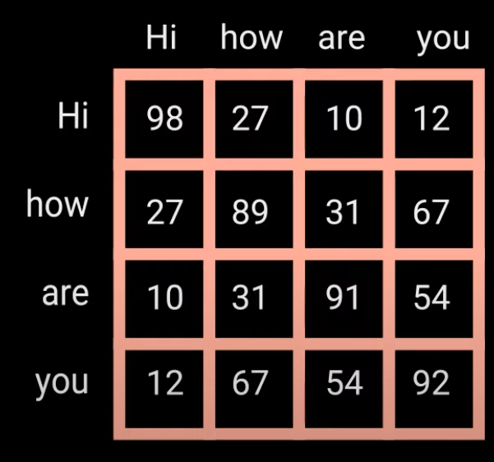
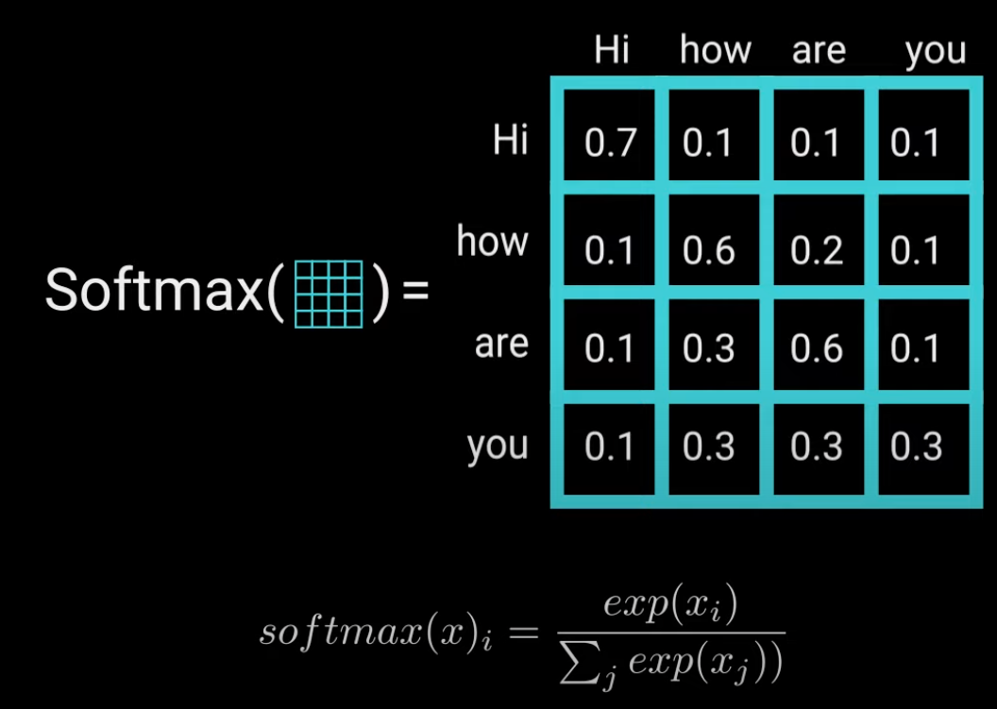
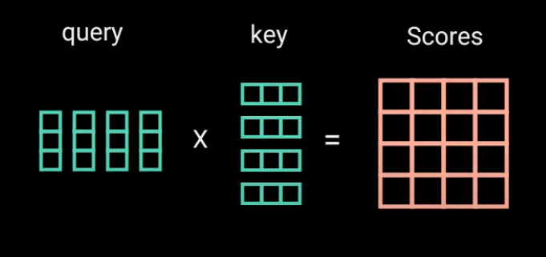
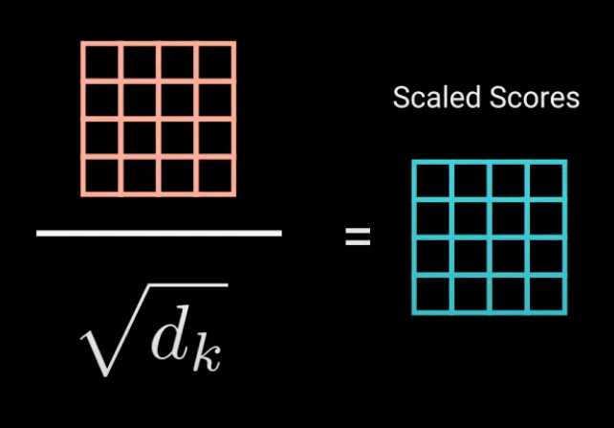
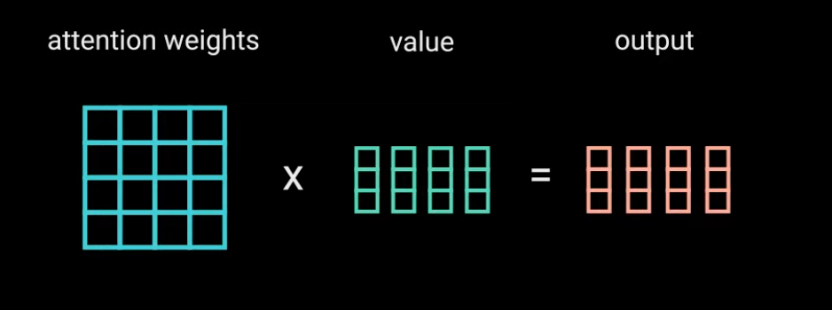
2. Score
Notes:
1. To achieve self-attention, we feed the input to 3 fully connected layers, to create tree component, a query, a key and a value.
2. Description of key query and value
3. The Score matrix: Tells you how much focus should a world be put with another word. Higher the score, higher the focus.
4. Then the score get scale down to allow for more stable gradient.
5. Softmax: Next you take the softmax, so that the value probability becomes between 0 and 1. Thus, the higher or lower number get closer to the min or max, which allows the model to be more sure of his decision.
6. Then you multiply the attention weight (which is the softmax) and multiply it by the value
7. This part finishes the weight.

Slide 21
In summary
Notes:
In summary: Multi-headed attention is a module in a transformer network that calculate the attention weights of the input and produces an output vector with encoded information on how each word should attend to all other word in a sequence.

